Slide 1
PRBANDH System
Real Time Monitoring System for Samagra Shiksha

Slide 2
Major features
Major features
Online submission of AWP&B
Approved Outlays
Progress under Civil Work
Submission of Monthly Physical and Financial Expenditure

Slide 3
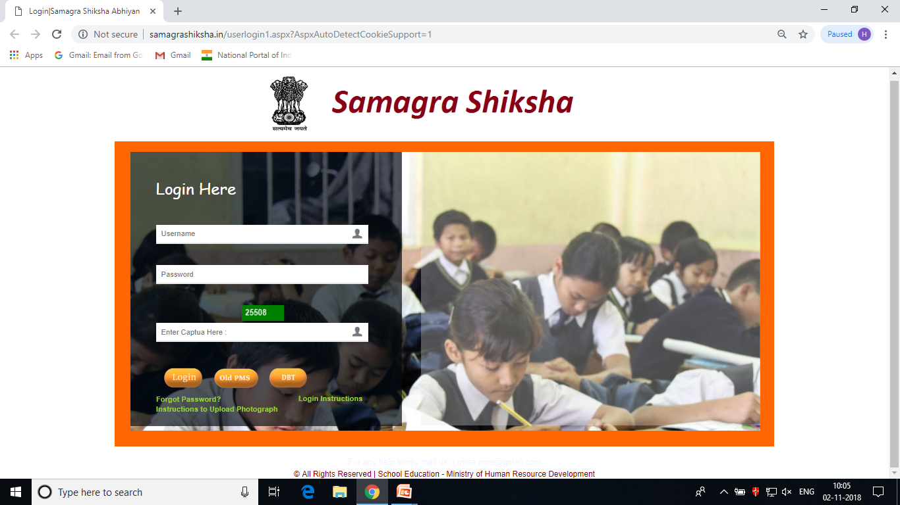
Overview
Website :
http://seshagun.gov.in or www.samagrashiksha.in
Screening
Entry Level
Authorization Level

Slide 4
User - Levels
Total
11.57 L
Districts – 2872 (Active – 1097) – 4 user for each District
Super User : 271/718, Elementary : 189/718, Secondary : 610/ 718 , TE : 29/718
Blocks– 7505 (Active – 1743)
Schools – 11.47 L (Active – 80099)

Slide 5
User – Definition
Can be fetched from 11 digit UDISE code of Schools
22 01 02 03 004
School (11 Digit UDISE code)
District (4 Digit district code : 2201)
Block (6 Digit Block code : 220102)

Slide 6
Login – Definition
District Level
Super User – 4 Digit District Code
Elementary – “U1” + District Code
Secondary – “U2” + District Code
TE – “U3” + District Code
Block Level
School Level
11 Digit School Code
6 Digit Block Code

Slide 7
Password – Definition
The default password is :
District Level : 4 Digit District Code
Block Level : 6 Digit Block Code
School level : 11 Digit UDISE Code

Slide 8
Locking / Screening Level
The screening level was given at Block / District level for physical progress :
If anything is modified by School can be Freeze and rejected by Block User
If anything is modified by Block can be Freeze and rejected by District user
Note : Last date of freezing the physical progress is 10th of every month. If any level skipped the freezing procedure which was updated by any level than system will lock the progress and cannot be reverted back . (The such cases will be apply on Completed works and Functional status only)

Slide 9
What to do at School Login ?
The following module have been given under school login to enter the physical progress approved by PAB every year :
New School : Construction / Functional Status with Photographs and Completion Certificate
Strengthening : Level wise construction status for Elementary / Secondary / Hr. Secondary
Toilet : Construction Status by Number’s with Photographs
Water : Construction Status by Number’s
ICT : Functional Status
Vocational Education : Functional Status / Placement Details / Monthly Progress
CWSN : Child wise entry of differently-abled boys / girls
Residential School : Functional Status

Slide 10
On-line Demonstration of School Login

Slide 11
What to do at Block Login ?
The following module have been given under block login to enter the physical progress approved by PAB every year for the concern block:
New School : Construction / Functional Status with Photographs and Completion Certificate
Strengthening : Level wise construction status for Elementary / Secondary / Hr. Secondary
Toilet : Construction Status by Number’s with Photographs
Water : Construction Status by Number’s
ICT : Functional Status
Vocational Education : Functional Status / Placement Details / Monthly Progress
CWSN : Child wise entry of differently-abled boys / girls
Residential School : Functional Status
Residential Hostel: Functional Status

Slide 12
Freezing Module at Block Login
The following module have been given under block login to freeze and reject the physical progress entered by the School and shown Completed / Functional:
New School : Construction / Functional Status
Strengthening : Construction status for Elementary / Secondary / Hr. Secondary
Toilet : Construction Status by Number’s
Water : Construction Status by Number’s
ICT : Functional Status
Vocational Education : Functional Status
Residential School : Functional Status
Note : All Civil Work approved by PAB for the district should be freeze

Slide 13
On-line Demonstration of Block Login

Slide 14
District Login

Slide 15
Entering Budget Sheet Received from State Office

Slide 16
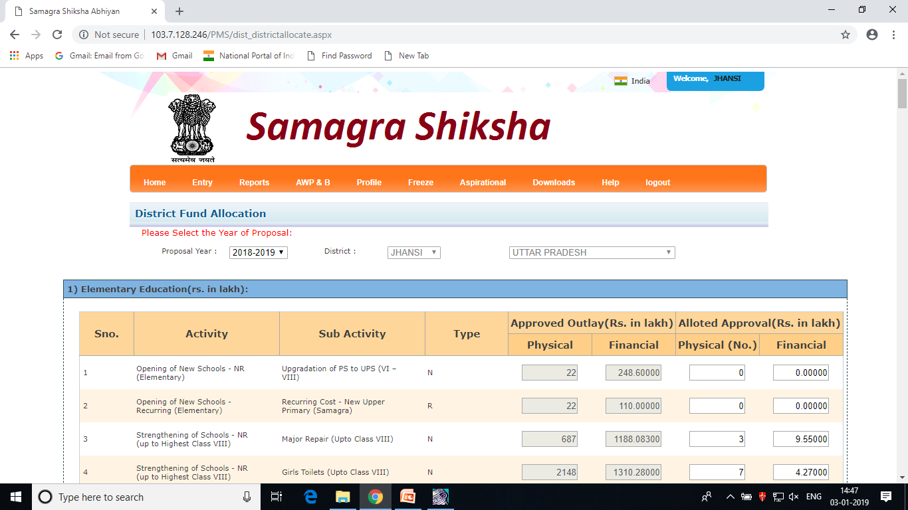
Budget Sheet Entry Received from HQ
Click on Entry → Budget Outlay, select the proposal year
Enter the activity wise budget cost-sheet received from HQ

Slide 17
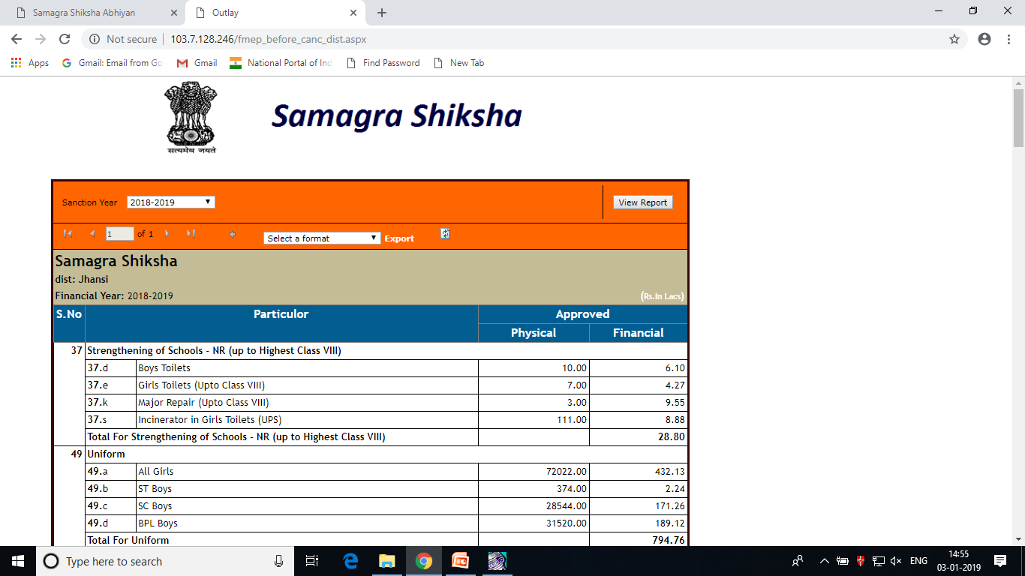
Budget Sheet - Report
Click on Report → Approved Outlay to view the entered budget sheet

Slide 18
Entering e-Costing Sheet for AWP&B

Slide 19

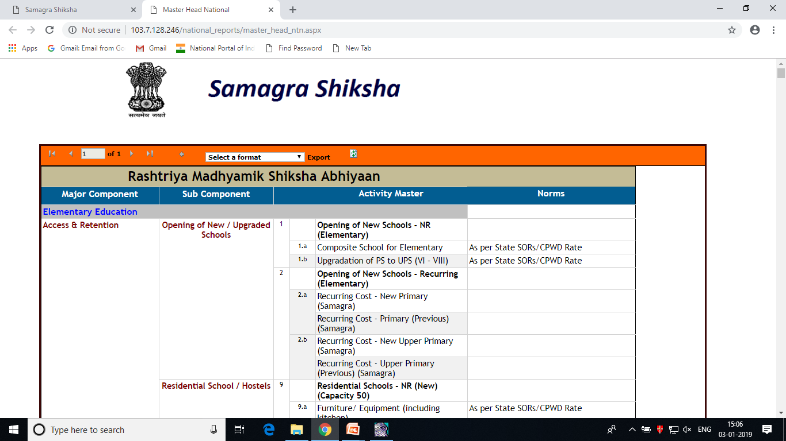
Master Heads
To generate the list of Master Heads , Click on AWP&B → Master Heads . After Clicking , the list will appear on the dashboard
The State can download the list using “Select a Format” option and by clicking “Export”
Accordingly District user can use the particular head in their Annual Plan & Budget of current year

Slide 20
Preparation of AWP&B
District user has to follow the procedure for submission of Annual Plan & Budget for current year :
  Export the Master Heads in Excel
  Propose the budget under different Activities according to the requirement
  Analyze the activities heads properly. If the heads were unable to fit with heads given in the list, send the email to State office , so that they request PMS team at MHRD to create the heads for the District in the prescribed format given in the Master List.
  The Heads will be opened within hours and activated for your District / State

Slide 21
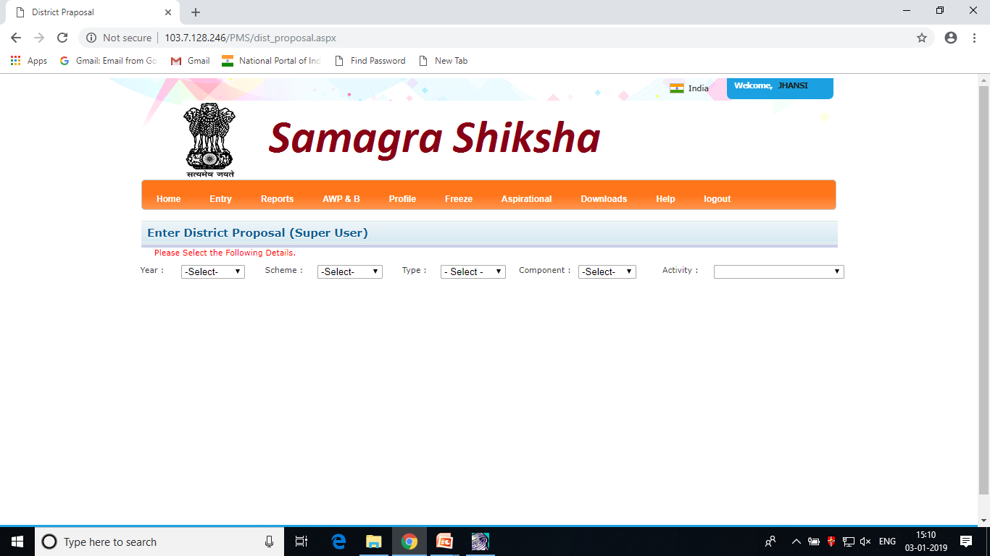
Plan Submission
Login with your Component user name and password.
Click on AWP&B → E-Costing. Following Screen will appear :

Slide 22
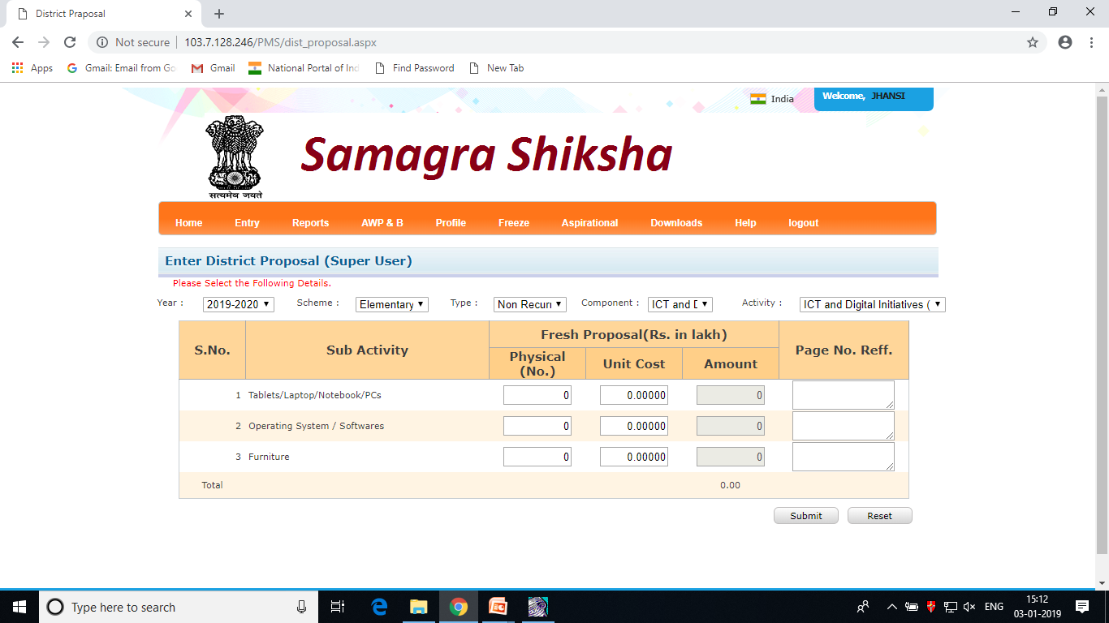
Plan Submission
Enter your proposal under the given module , The each and every sub-activity will be displayed according to the selection of the drop-down given in the module.

Slide 23
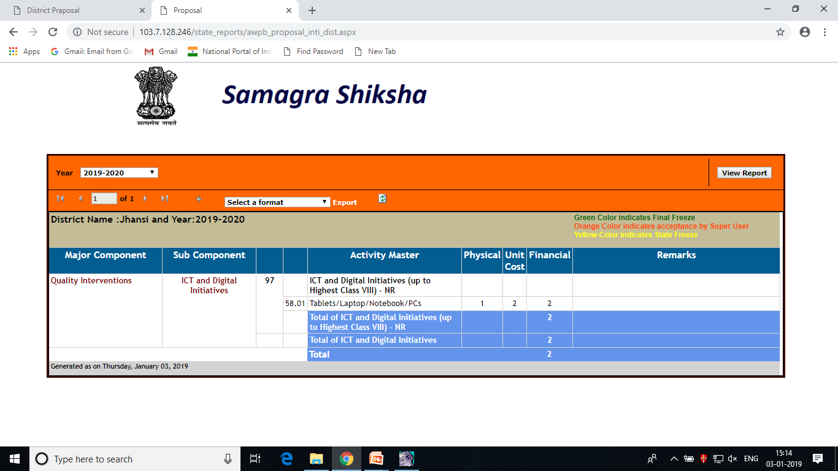
Submitting Plan to State
After entering the activity wise cost-sheet, District user will be able to see the full proposal of the component before submitting plan to State Level
To view the Plan , click on AWP&B → Reports → Detailed/Integrated, The following screen will appear :

Slide 24
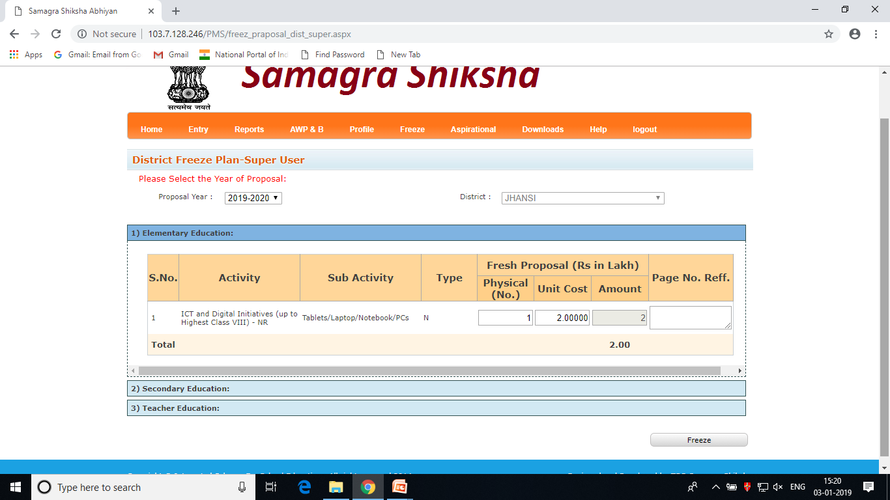
Submitting Plan to State
After finalizing the cost-sheet, click on AWP&B→ Freeze Proposal option to freeze the plan and submit it to State Level

Slide 25
School Wise – Physical Progress
The following module have been given under District login to enter the physical progress approved by PAB every year for the concern District:
New School : Construction / Functional Status with Photographs and Completion Certificate
Strengthening : Level wise construction status for Elementary / Secondary / Hr. Secondary
Toilet : Construction Status by Number’s with Photographs
Water : Construction Status by Number’s
ICT : Functional Status
Vocational Education : Functional Status / Placement Details / Monthly Progress
CWSN : Child wise entry of differently-abled boys / girls
Residential School : Functional Status
Residential Hostel: Functional Status

Slide 26
Freezing Physical Progress
The following module have been given under District login to freeze and reject the physical progress entered by the Block and shown Completed / Functional:
New School : Construction / Functional Status
Strengthening : Construction status for Elementary / Secondary / Hr. Secondary
Toilet : Construction Status by Number’s
Water : Construction Status by Number’s
ICT : Functional Status
Vocational Education : Functional Status
Residential School : Functional Status
Residential Hostels : Functional Status
Note : All Civil Work approved by PAB for the district should be freezed

Slide 27
On-line Demonstration to enter Physical Progress

Slide 28
Entering Expenditure against Approval

Slide 29
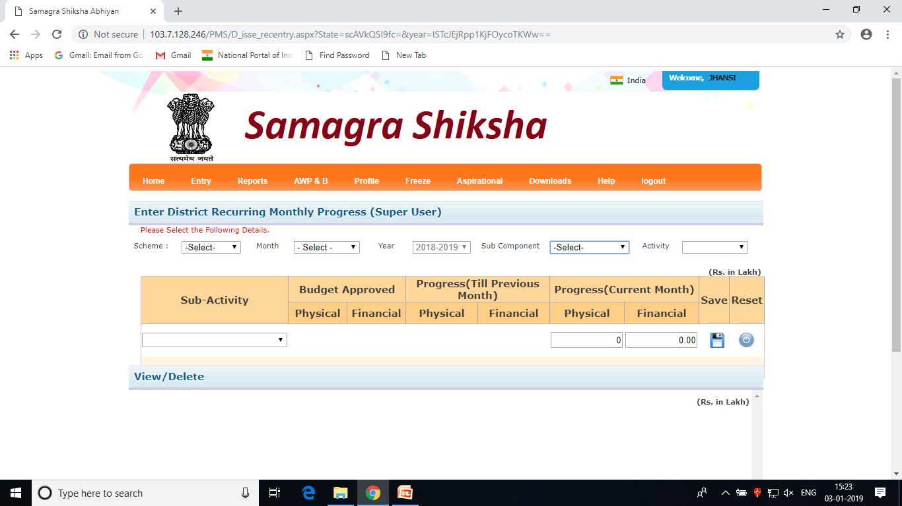
Financial Progress for Recurring
Monthly progressive figure should be entered under Physical and Financial Expenditure for selecting component approved
Click on Entry→ Expenditure → : Select Financial year : Recurring : After selecting the parameter following screen will appear :

Slide 30
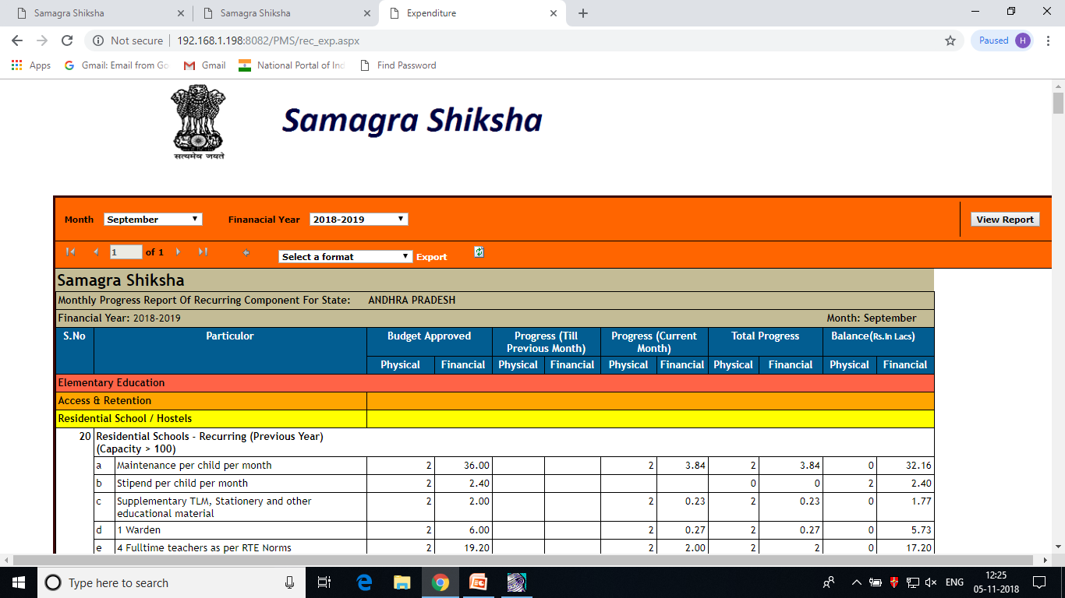
Check the Report
Click on Report → Expenditure : Recurring : After selecting the parameter following report will appear :

Slide 31
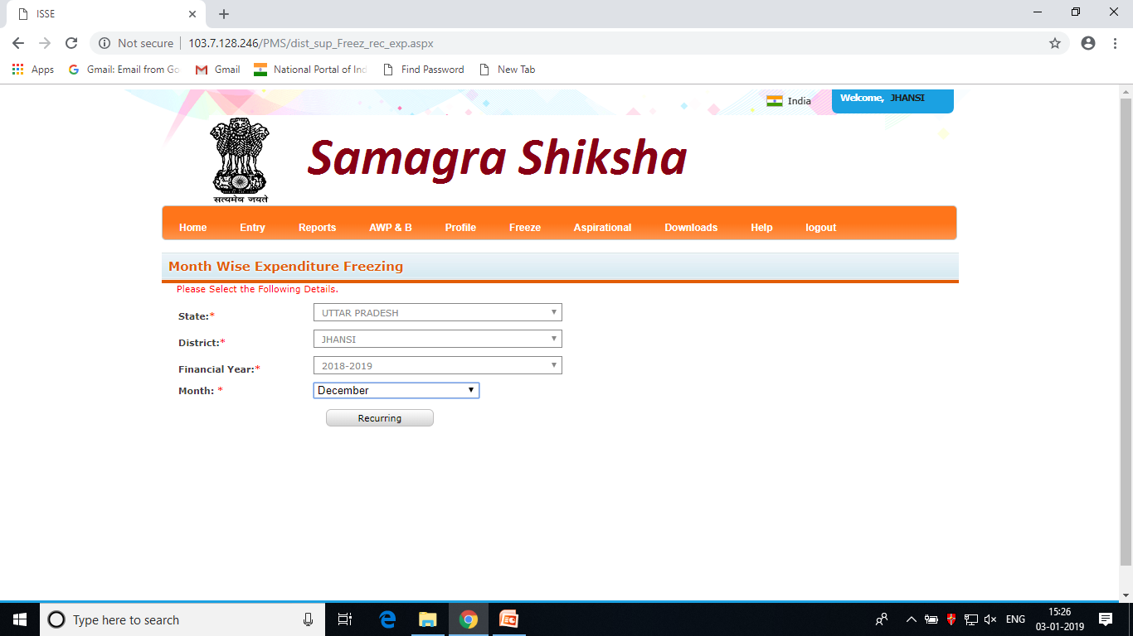
Freezing the Expenditure
Click on Freeze → Expenditure: Select Financial year : Month : Recurring, As shown in the Screen

Slide 32
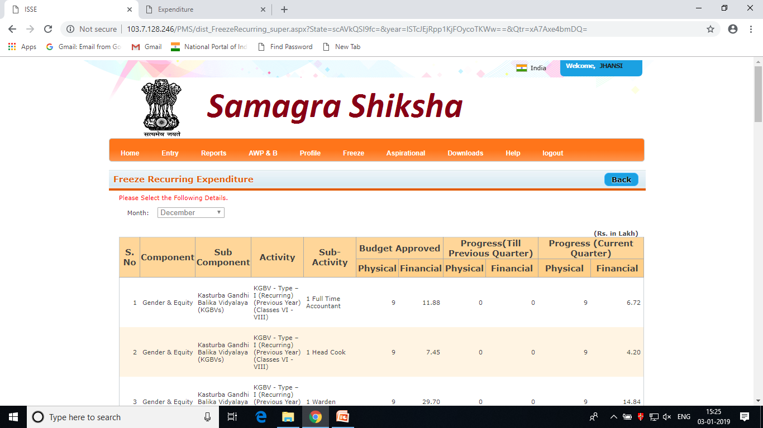
Freezing the Expenditure
Click on Freeze button given at bottom of the screen
Note : Expenditure once freeze cannot be modify for that month, You have to send request to unlock the month for modification. State have a facility to unlock the expenditure before 10th . After 10th every thing is locked.

Slide 33
Reports under PMS
Approved Outlay
Statement of Expenditure (SOE)
Physical Approvals
Physical Progress
School Wise physical progress approved under Civil Work

Slide 34
Assistance
Frequently Asked Questions
PMS Team :
Email – id : rmsa.pms@gmail.com
Team Members |  | Contact No.
Rajiv Mehra | Chief Consultant (MIS) | 7827657230
Prashant Dixit | Programmer | 8512898918

Slide 35
Project Monitoring System (PMS)
Discussion – Open Session

